Slide 1
Hierarchical Memory Networks
Motivation:
computationally scalable for applications which require the network to read from extremely large memories.
hard attention mechanisms based on reinforcement learning are challenging to train successfully.
Hierarchical memory network
-- a hybrid between hard and soft attention memory networks

Slide 2
Hierarchical Memory Networks
Memory: memory cells are organized into groups and the groups can further be organized.
hashing-based, tree-based, clustering-based
Reader: HMN readers use soft attention only over a selected subset of the memory.
selecting memory subsets is guided by a maximum inner product search algorithm

Slide 3
Neural Turing
Machines
CAN NEURAL NETS LEARN PROGRAMS?

Slide 4
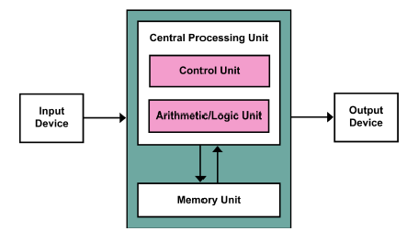

Slide 5
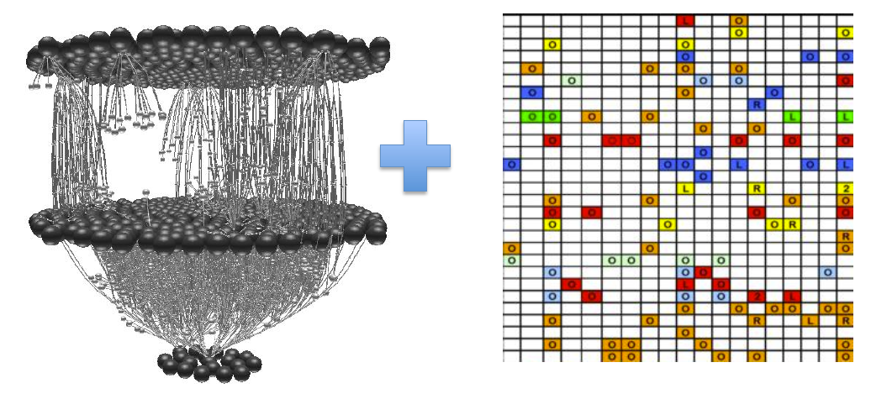

Slide 6
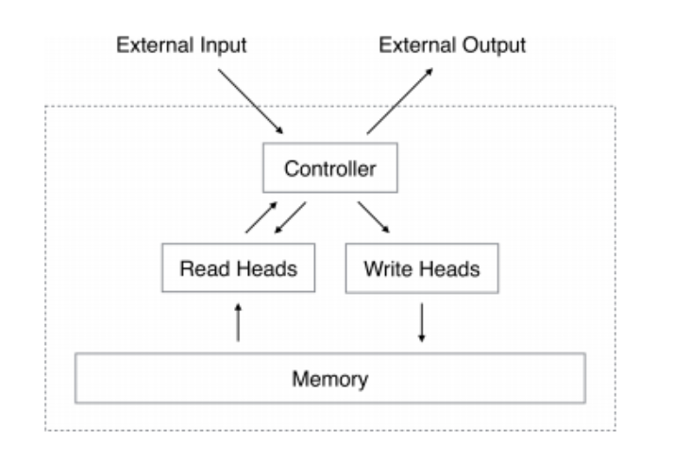

Slide 7
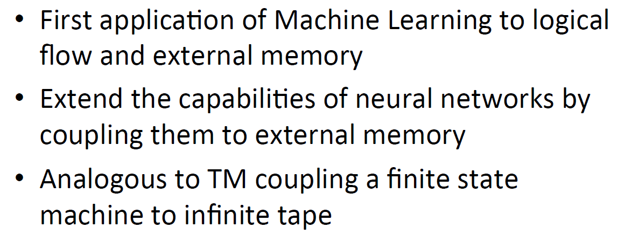
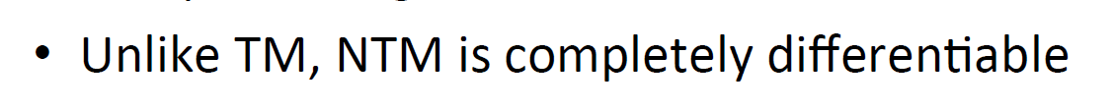
Neural Turing Machines

Slide 8
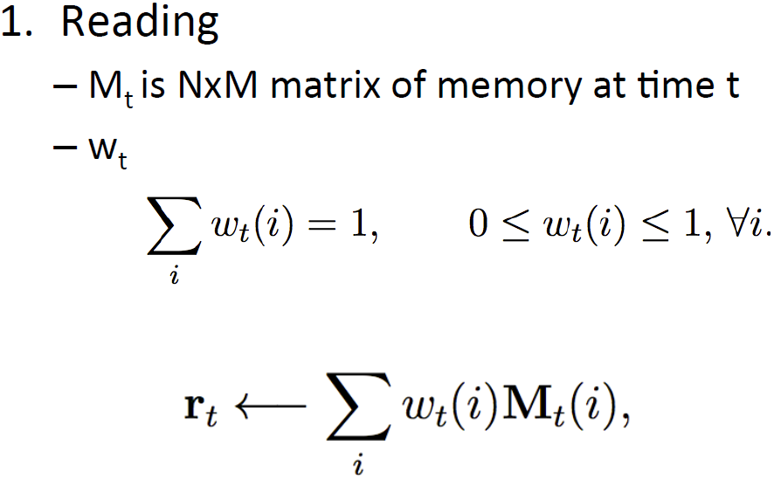
Neural Turing Machines

Slide 9
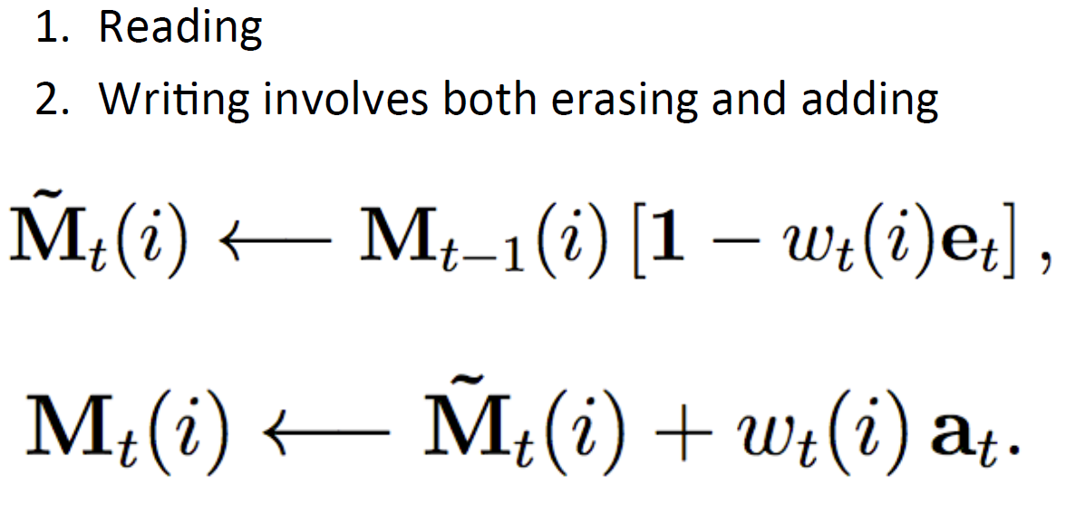
Neural Turing Machines

Slide 10
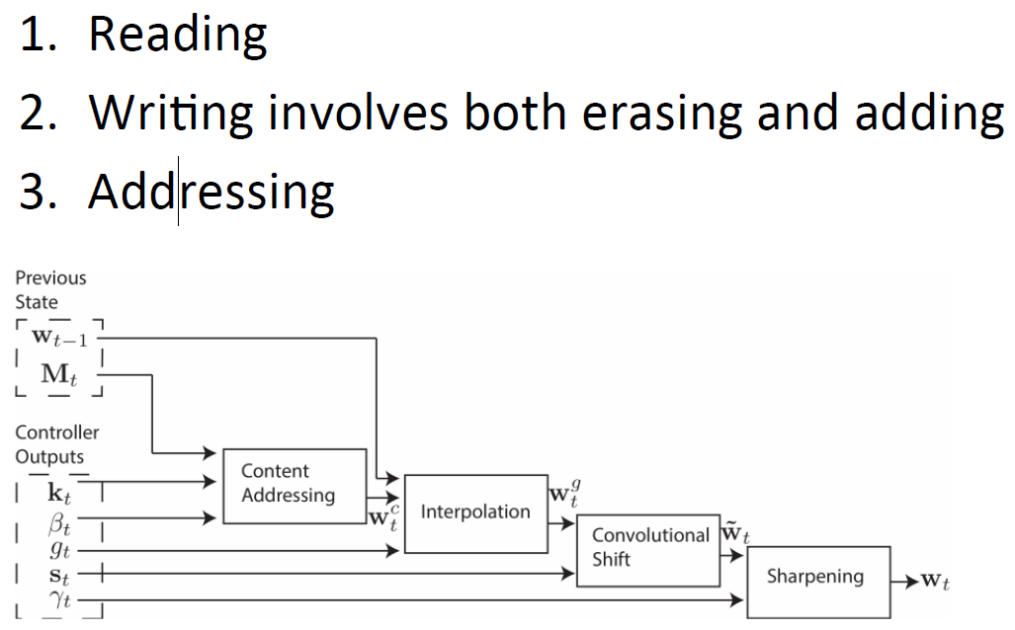
Neural Turing Machines

Slide 11
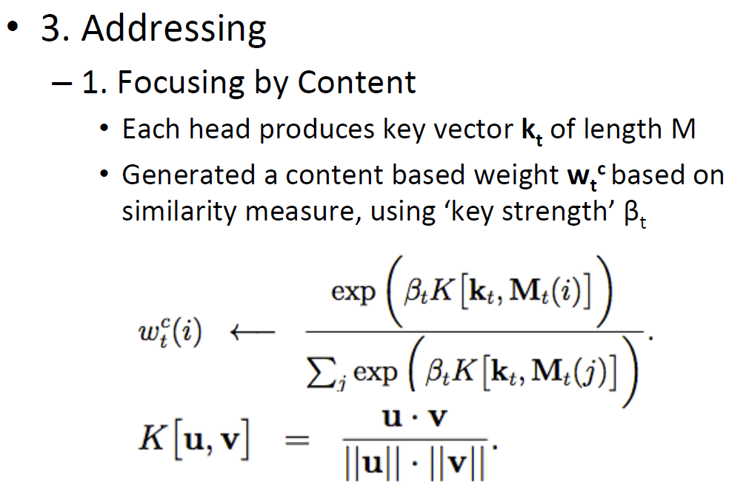
Neural Turing Machines

Slide 12
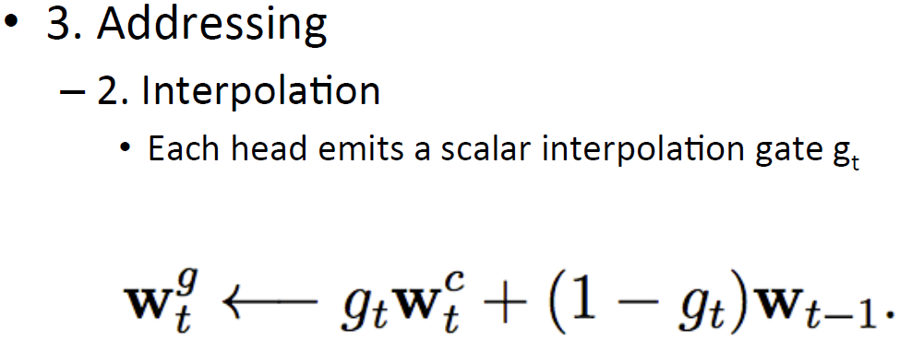
Neural Turing Machines

Slide 13
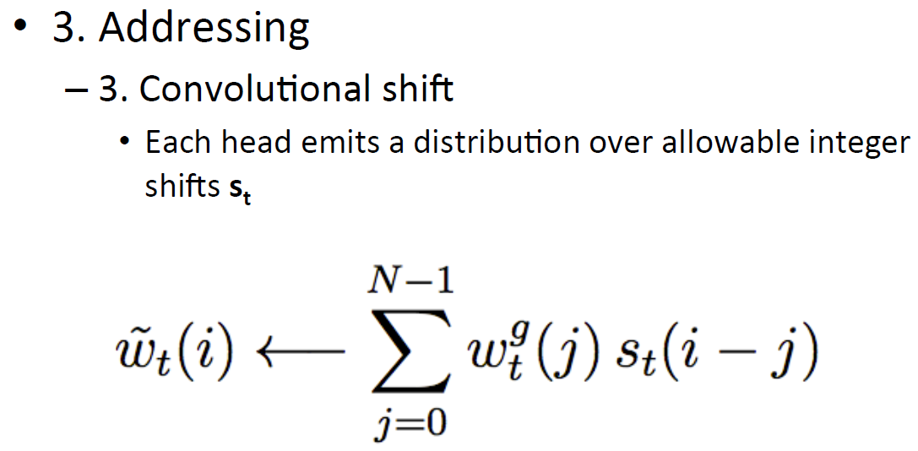
Neural Turing Machines

Slide 14
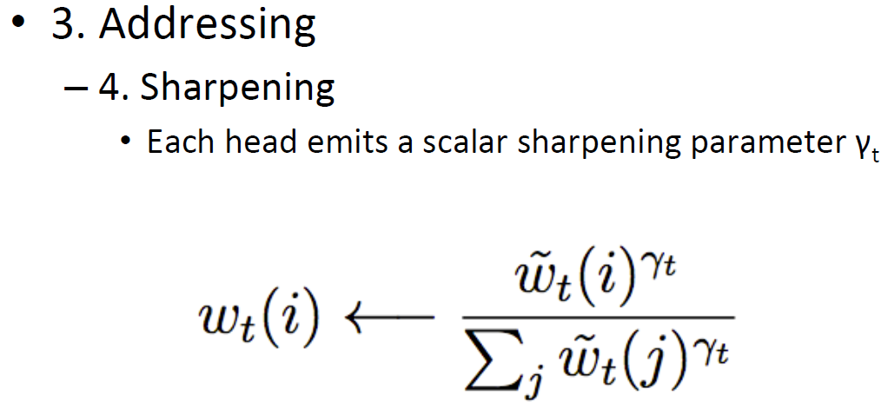
Neural Turing Machines

Slide 15
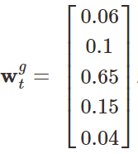
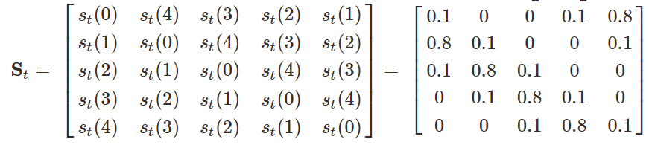
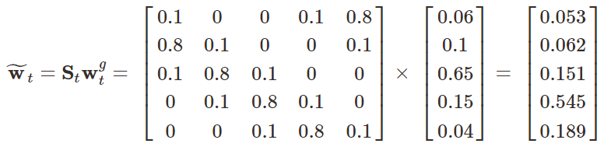
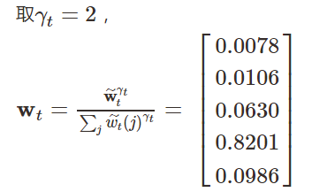
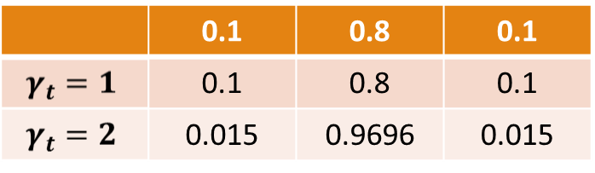

Slide 16
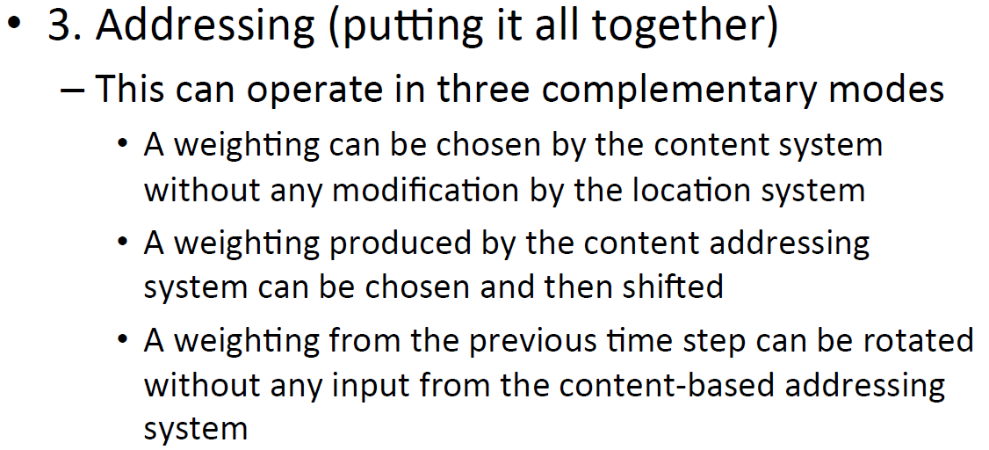
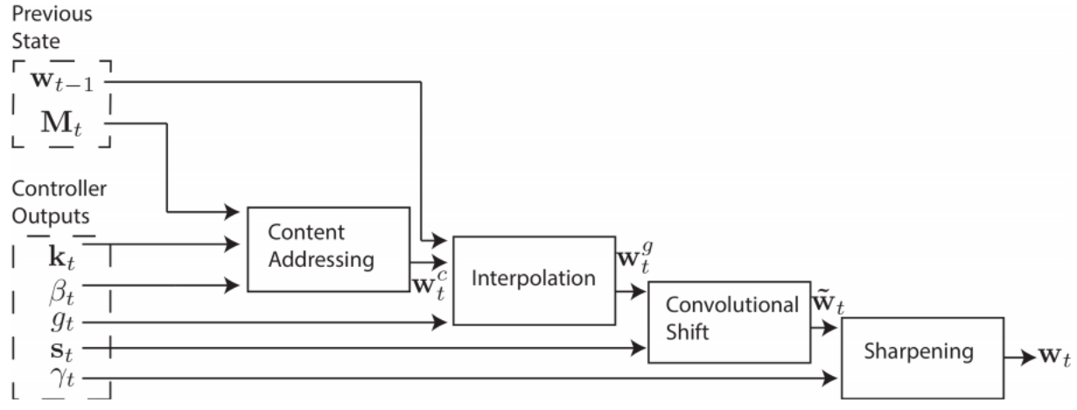
Neural Turing Machines

Slide 17
Neural Turing Machines

Slide 18
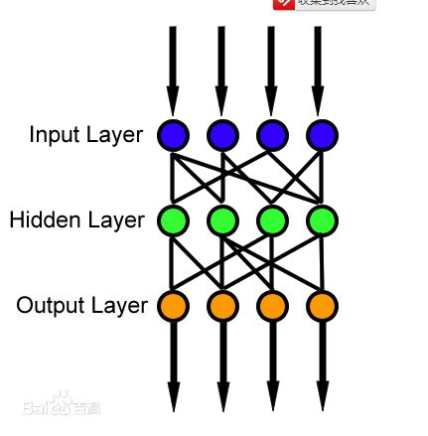
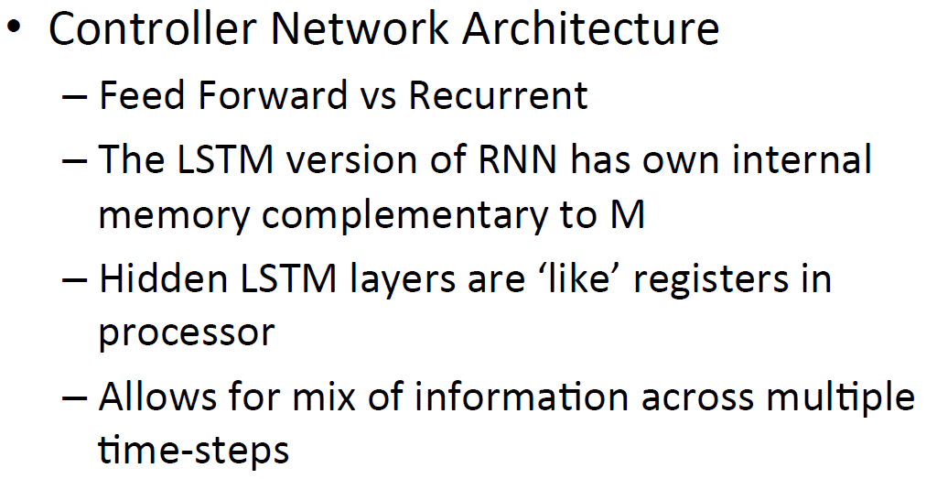
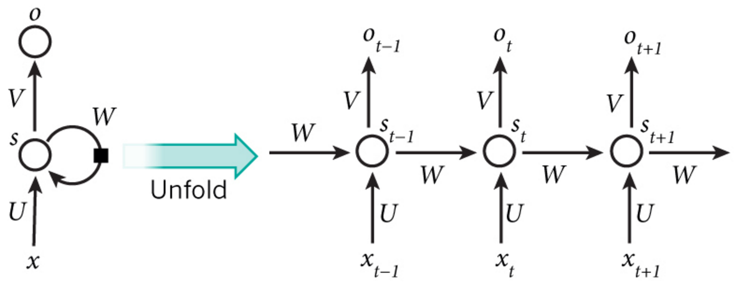
Neural Turing Machines

Slide 19
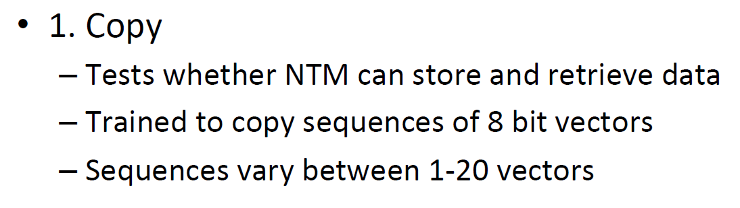
Experiments

Slide 20
Experiments

Slide 21
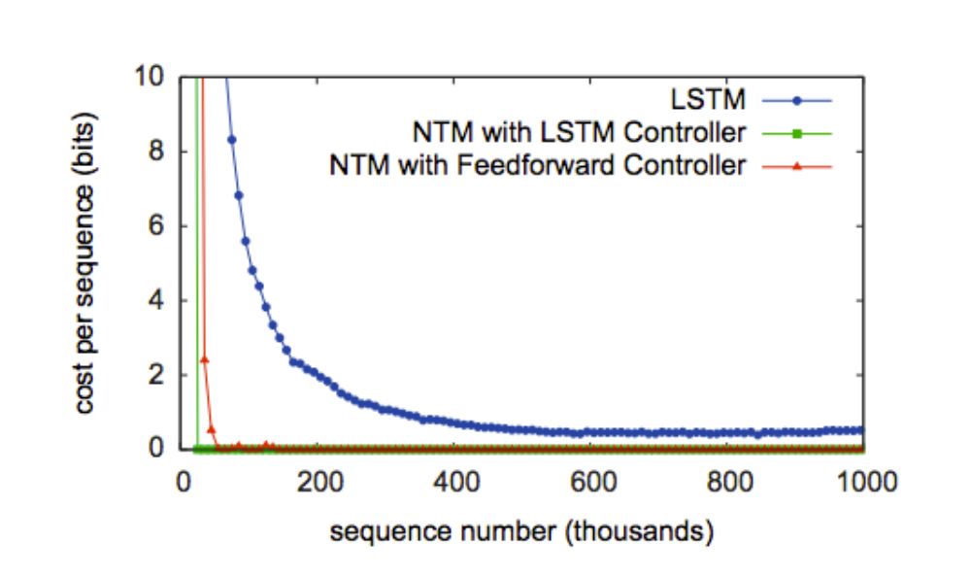
Experiments - Copy

Slide 22
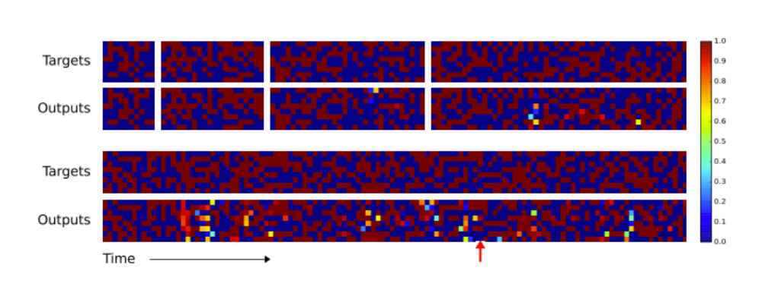
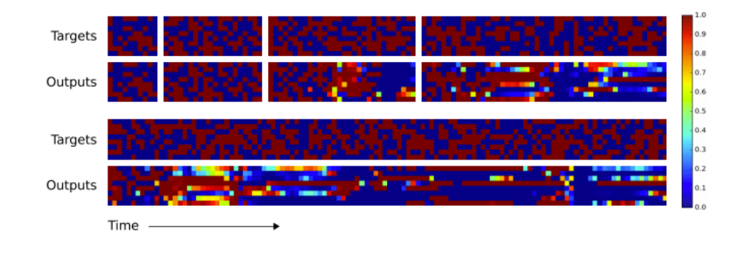
Experiments - Copy

Slide 23
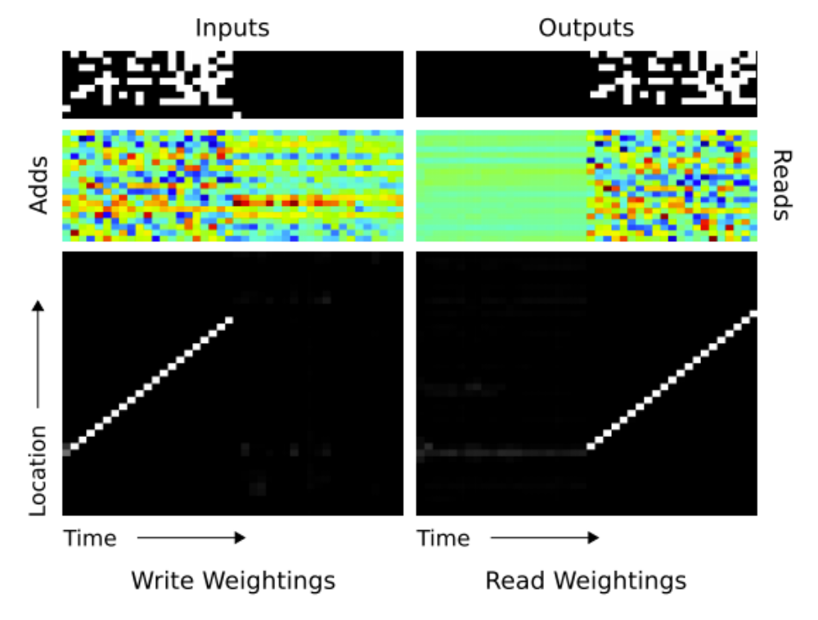
Experiments - Copy

Slide 24
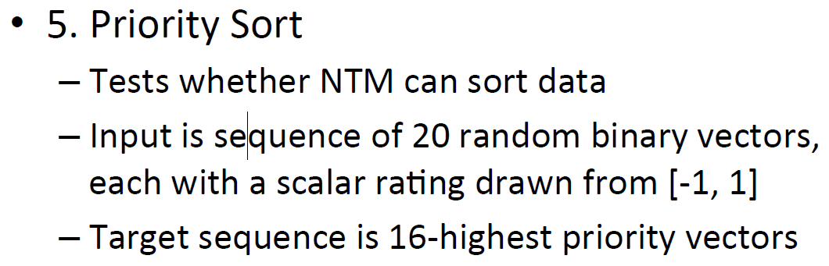
Experiments – Priority Sort

Slide 25
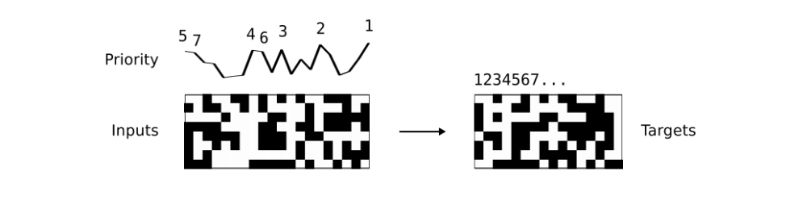
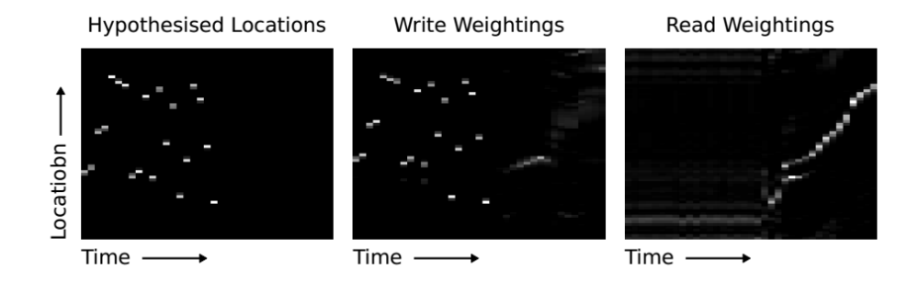
Experiments – Priority Sort

Slide 26
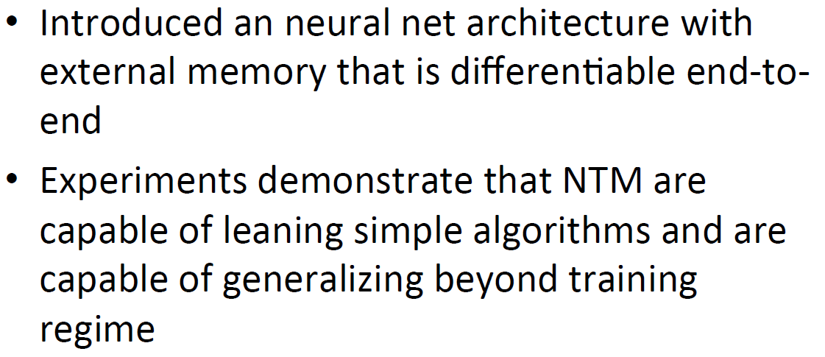
Conclusion

